Slide 1
Support Org Chart + KB Articles
Athziri Vega, Carter Ward, Jeremy Martel, Logan Foster

Slide 2
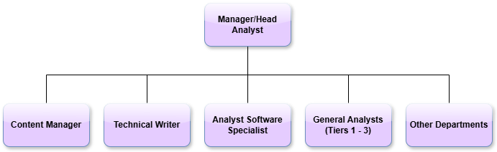
Overview Chart
Manager/Head Analyst: Oversees all analysts, handles escalations, and communicates with other departments
Content Manager: Maintains FAQ and support page content, works with Technical Writers on priorities
Technical Writer: Writes KB articles, translates complex concepts into user-friendly language
Analyst Software Specialist: Analyzes client needs, translates requirements, collaborates with Tier analysts
General Analysts (Tiers 1 – 3):
Tier 1: basic issues
Tier 2: deeper product knowledge
Tier 3: complex escalations

Slide 3
Other Departments
Engineering: When a customer finds a bug, engineering would look in to the code and help with a solution.
Product management: Will handle Feedback on features/improvements from customers so it will be considered in future updates.
Finance: When questions involve billing, invoices, subscriptions, or refunds that support can not resolve directly.
IT: Helps when issues are caused by infrastructure instead of the software itself.

Slide 4
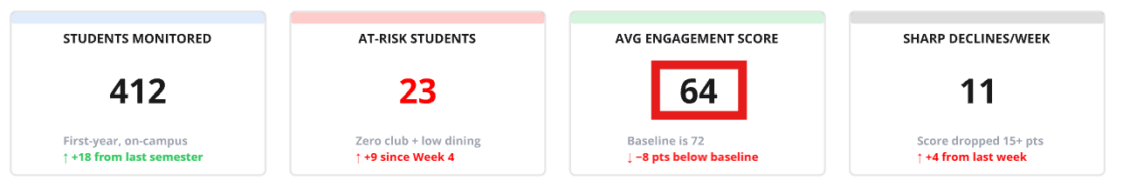
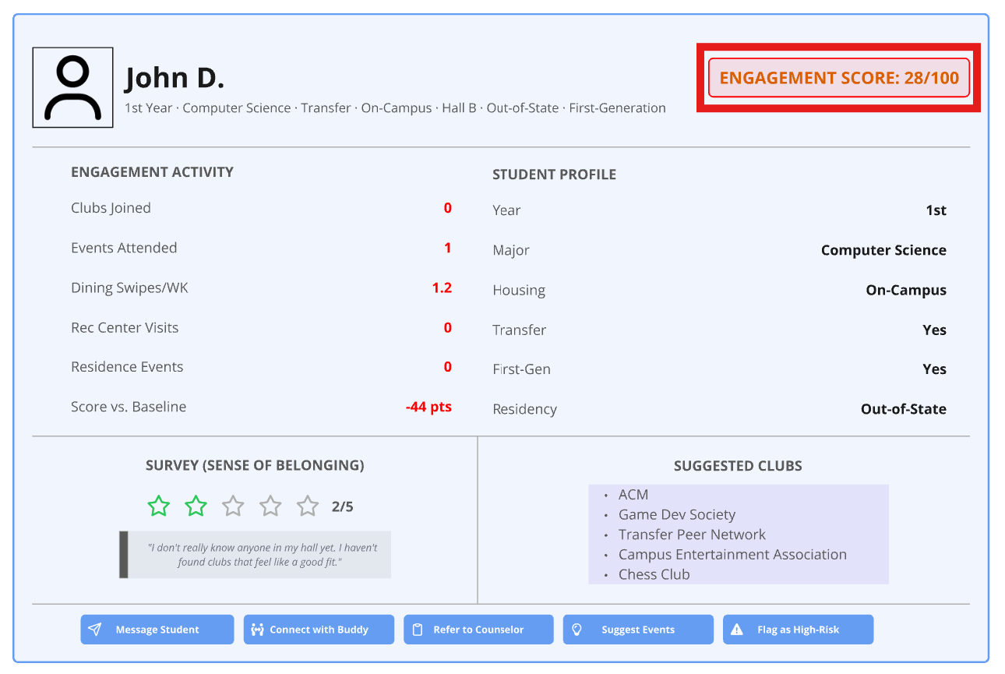
KB Article #1 (Carter)
Title: SEA: Engagement Score Not Updating or Displaying Incorrectly
Product: Social Engagement Accelerator (SEA)
Product Version: 1.0
Summary: Student engagement scores are not reflecting recent activity or are displaying below the expected baseline
Content:
Engagement scores pull from clubs, dining, rec center visits, events, and residence life — if one source is broken, the score will be off
Open the student's profile and check the Engagement Activity section to see which categories are showing zero
Check that no dashboard filters are narrowing the population before assuming the score itself is wrong
If nothing stands out, contact your SEA administrator to confirm all data integrations are syncing
Any student scoring below the term baseline will display in red
Internal Secrets:
Scores recalculate overnight, not in real time
If scores have not updated in over 48 hours, escalate to engineering to check the pipeline logs
The most common cause is a broken API connection to dining or housing after a campus IT update
Functional Use: Support, Professional Services, Customer Success

Slide 5
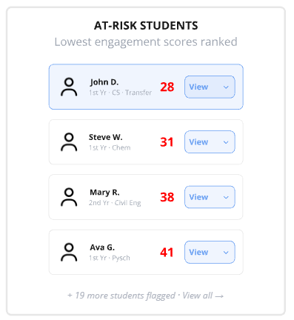
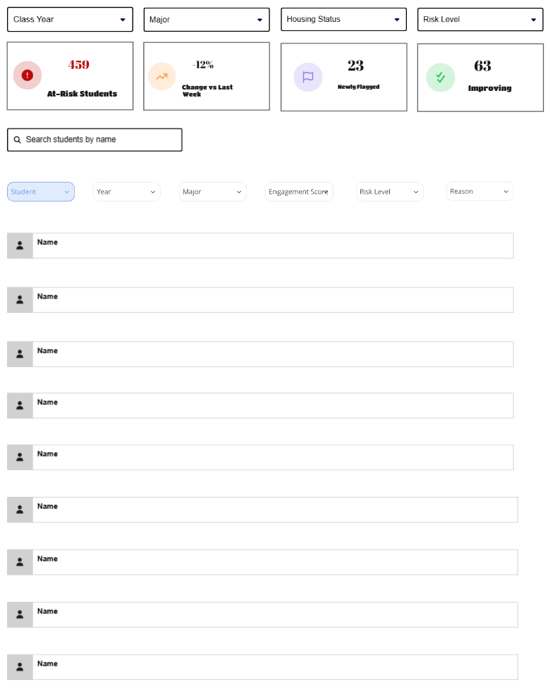
KB Article #2 (Carter)
Title: SEA: At-Risk Student List Showing Incorrect Results or Filters Not Working
Product: Social Engagement Accelerator (SEA)
Product Version: 1.0
Summary: The At-Risk Students list is returning too many or too few students, or filters are not producing the expected output
Content:
Before assuming something is broken, verify no unintended filters are active — Class Year, Major, Housing Status, and Risk Level stack on top of each other
The "Newly Flagged" tile only counts students flagged this week, not carry-overs from prior weeks
If a specific student is missing, search for them directly and confirm their score actually meets the at-risk threshold
Students marked as "Improving" still count toward the total at-risk number
Internal Secrets:
The at-risk threshold is set per institution during implementation; if clients think too many or too few students are flagged, that is a PS or Customer Success conversation
"Change vs Last Week" compares against the prior Monday snapshot, not a rolling 7-day window
If Risk Level was never configured during onboarding, filtering by it will always return the full list
Functional Use: Support, Professional Services, Customer Success

Slide 6
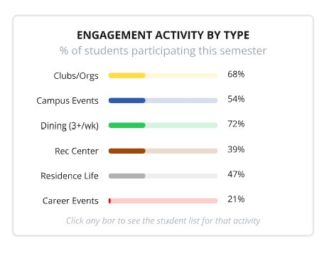
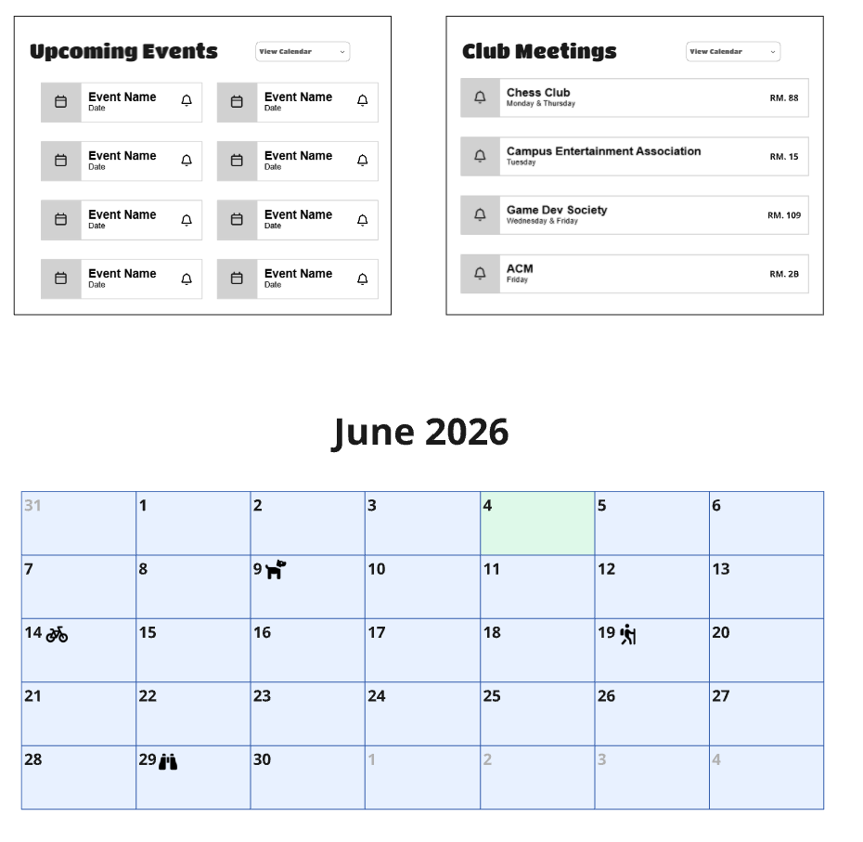
KB Article #3 (Carter)
Title: SEA: Events Calendar Not Displaying Upcoming Events or Club Meetings
Product: Social Engagement Accelerator (SEA)
Product Version: 1.0
Summary: The Events page is not populating upcoming events or club meetings, or entries are missing for specific dates
Content:
The Events page pulls from your campus scheduling system, so missing data usually means a sync or integration issue upstream
Check the Date filter first since the default view has a set window that may not include the dates you are looking for
The Upcoming Events and Club Meetings panels pull from separate sources, so one can work while the other does not
If a specific event is missing, confirm with your campus events team that it is published and set to active in the source system
Missing or incorrect room numbers need to be corrected in the campus scheduling system, not in SEA
Internal Secrets:
The calendar syncs every 4 hours during business hours and once overnight, so recently added events may not appear right away
If events appear on the calendar but not in the panel, room number data and event data come from separate endpoints and a partial failure can cause this
If all events disappeared after a campus IT update, check whether the API credentials for the events system were rotated
Functional Use: Support, Professional Services, Customer Success

Slide 7
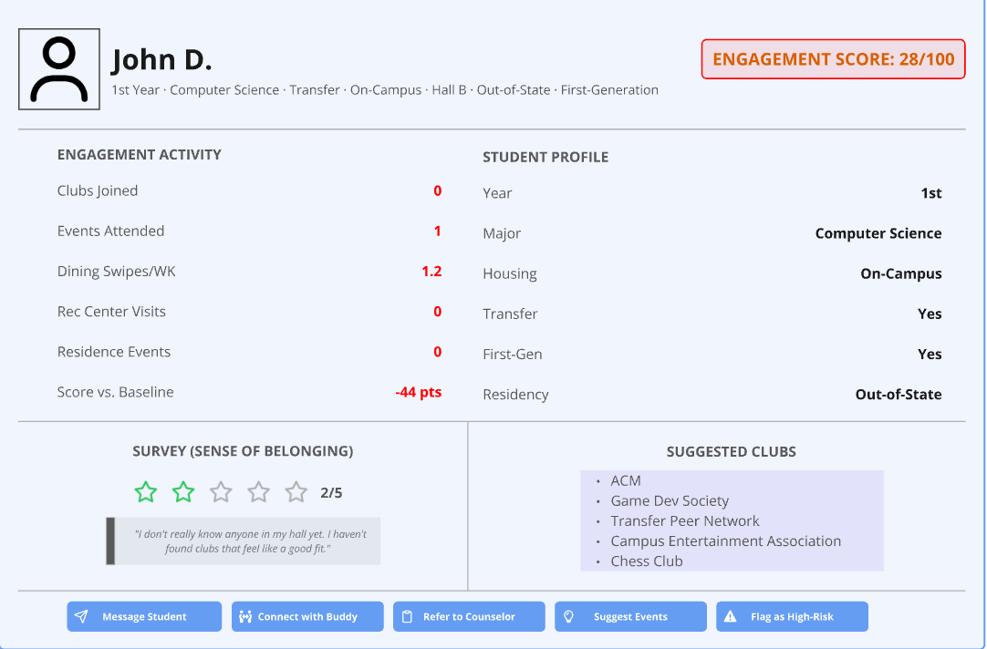

KB Article #1 (Athziri)
Title: SEA: How to Connect Student with a Buddy
Product: Intended for users who aren't as comfortable talking to staff. Allows staff to find other students/mentors to help with social engagement. Buddies will help students adjust to school life and help them get involved in events.
Summary: Help staff users navigate connect system to link students together.
Content:
-What is Connect?
-How is it beneficial
-Where to find it
-Guide on how to use it
-Removing or changing connect buddy
Internal Secrets: Multiple buddies should not be linked to one student
Functional Use: Product Management

Slide 8
KB Article #2 (Athziri)
Title: SEA: Data Privacy and Security
Product: Account Settings which includes 2 step verification, password change, and ways to limit specific data view(Privating so only limited staff can see data)
Summary: Protect student data such as personal information and school stats
Content:
-Why it's important
-Limiting access
-What to do if you lose access to your account
-How to set up lock system(if something happens, you can lock account from another device/account)
-Guide on how to change password
Internal Secrets: 10 Second cooldown on changing password and should be changed every 2 months.
Functional Use: Support, IT

Slide 9
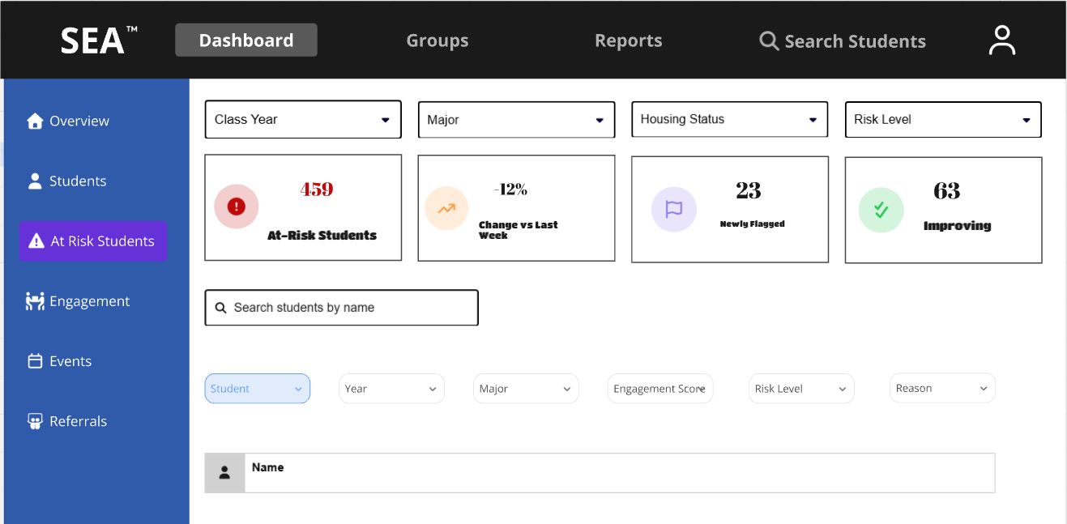
KB Article #3 (Athziri)
Title: SEA: How to Update At-Risk Students
Product: At-Risk tab allows staff to view which students aren't involved in many events/activities/clubs. It shares what the students are involved in and feedback they have. The purpose it to find the patterns to see the reason there isn't engagement and guide student for higher engagement results.
Summary: Update student involvement to identify if they are still considered At-Risk
Content:
-How to navigate tab
-What is considered At-Risk
-Ways to rise engagement
-How to change student status
Internal Secrets: Requirements must be met to flag student(specific amount of events or clubs)
Functional Use: IT, Product Management

Slide 10
KB Article #1 (Jeremy)
Accelerator: Social Engagement Accelerator
SEA: Student Engagement Profile Overview
Summary
Explains what a student profile shows and how staff can use it to understand a student’s campus involvement.
What the content is
What it is meant for
Shows engagement score, activity history, notes, and risk status.
Connects data from events, clubs, housing, dining, and other campus activity.
Gives staff a quick view before deciding what support is needed.
Staff who need a simple view of a student’s engagement before contacting them or referring them to another department.
Why this KB is needed
Without a clear profile overview, staff may miss important context or repeat work another team already completed.
Functional Use: Support, Student Affairs, Advisors, Customer Success
06/30/2026
10

Slide 11
KB Article #2 (Jeremy)
Accelerator: Social Engagement Accelerator
SEA: Understanding Low Engagement and At-Risk Students
Summary
Defines what low engagement means in SEA and explains how the At-Risk Students list should be used by campus staff.
What the content is
What it is meant for
Explains how students are flagged based on engagement score and recent activity.
Shows why filters like term, major, housing, and risk level matter.
Helps staff decide when outreach or follow-up is needed.
Advisors, student success teams, and support staff who monitor students who may be disconnecting from campus.
Why this KB is needed
This KB helps teams find students early, before low involvement turns into a bigger retention problem.
Functional Use: Support, Student Affairs, Advisors, Customer Success
06/30/2026
11

Slide 12
KB Article #3 (Jeremy)
Accelerator: Social Engagement Accelerator | Version: 1.0 and above
SEA: Engagement Reports and Department Usage
Summary
Explains what engagement reports include and how departments can use them to make decisions about student support.
What the content is
What it is meant for
Summarizes engagement trends by student group, term, department, or activity type.
Helps teams compare activity levels and identify where support is needed.
Can be used in meetings, planning, and follow-up conversations.
Support, Student Affairs, Customer Success, and leadership teams that need clear engagement data.
Why this KB is needed
Reports give all departments the same source of information, which helps teams make better decisions together.
Functional Use: Support, Student Affairs, Advisors, Customer Success
06/30/2026
12

Slide 13
Accelerator:
Social Engagement Accelerator
1.0 and above
How do I remove a user from the account?
To remove a user from your account you must first be logged in as an administrator, (if you are not an admin please contact your school's relevant department). Once logged in, select the manage users' section in the Admin actions section of the menu on the left. From there find the user you would like to remove via the search bar, and click on the user. You will then see manage user, from there you can remove the user from the account after confirming the selection.

Slide 14
Accelerator:
Social Engagement Accelerator
1.0 and above
How do I update a user's status/permissions?
To update a user's status you must first be logged in as an administrator, (if you are not an admin please contact your school's relevant department). Once logged in, select the manage users' section in the Admin actions section of the menu on the left. From there find the user you would like to update via the search bar and click on the user. You will then see manage user; from there you can give the user admin status or change what permissions they have.

Slide 15
Accelerator:
Social Engagement Accelerator
1.0 and above
How do I remove incorrect data from the system
To remove incorrect data from the application, first go to the manage data section of the application in the main menu (note: may need certain permissions to edit data in the application, please contact your admin if you are unable to edit data). From there you will be able to see all of the data you have, organized depending on the user. Once you have located the data you wish to edit select edit data on the data box. Be careful editing data as it may cause issues if deleted improperly, replacing a number with 0 instead of leaving it blank is a potential way to avoid issues.

